Slide 1

Python Foundations
Supervisor: Dr. Atlas Khan
Student:
Olaoluwa Joaquim Ezekiel (Student ID: 202201029)

Slide 2
CUSTOMER CHURN PREDICTION IN TELECOM INDUSTRY
TABLE OF CONTENT
Introduction
Methods
Data Analysis
Data Preprocessing
Build and evaluate the models
Conclusion

Slide 3
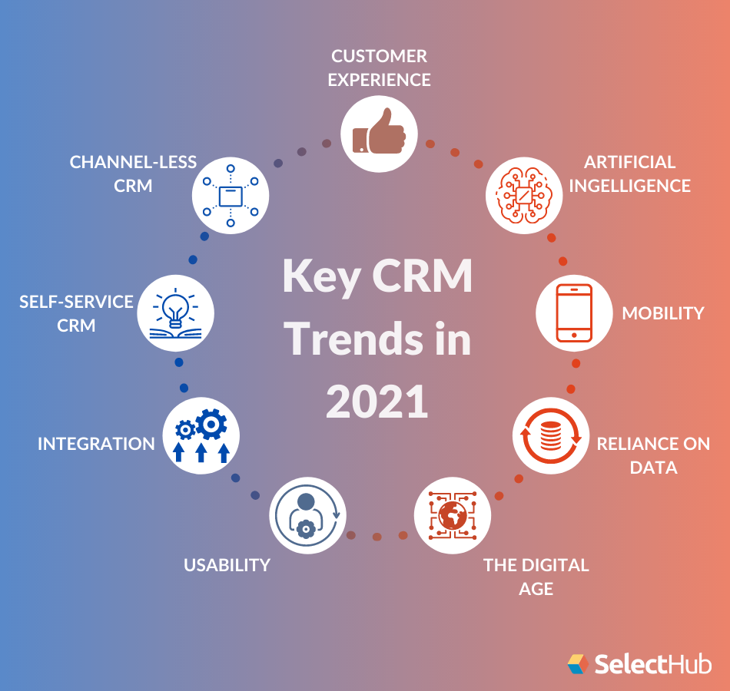
INTRODUCTION
Due to the high cost of acquiring new customers, customer churn prediction has emerged as an indispensable part of telecom sectors’ strategic decision making and planning process. It is important to forecast customer churn behavior to retain those customers that will churn or possible may churn.
The cost of saving current customers is lesser than attractive other company customers or free customers to use of telecom company services, so it is important to predict the group of customers that are in-danger and persuade them to stay.

Slide 4
PROBLEMS AND CHALLENGES
Acquiring new customers always costs heavily and this makes the predictive churn model appealing for businesses that aim at retaining customers and maximizing profits. Although predicting customer churn seems to be easy initially it involves several challenges.
In summary, the business problem here is to predict behavior to retain customers by analysing all relevant customer data i.e., create a model that can predict customers that will churn in the telecom industry
Some of the challenges faced by Data Scientist and Machine learning engineers in building a model using python are:
Lack of a ‘silver bullet’ methodology
Features and exploratory analysis
Validating churn model performance

Slide 5
METHODOLOGY
The followings are steps to be taken in course of analysing and predicting customer churn in the Telcom Industry.
Descriptive statistics of the dataset
Exploratory Data Analysis (univariate and multivariate analysis)
Data processing i.e., data cleaning, data normalization, scaling, handling missing values and removal of outliers
Describe on which predictive method to use e.g., Linear Regression
Build and evaluate the models
Compare their performance
Interpret the models

Slide 6
Imported Libraries
Libraries for data analyze and manipulation - Pandas, and Numpy
Libraries for data visualizing - Matplotlib and Seaborn
Libraries for data Preprocesing - sklearn.model_selection, sklearn.preprocessing, and imblearn.over_sampling
libraries for Model building - sklearn.linear_model, sklearn.metrics, sklearn.svm, sklearn.neighbors, and sklearn.ensemble

Slide 7
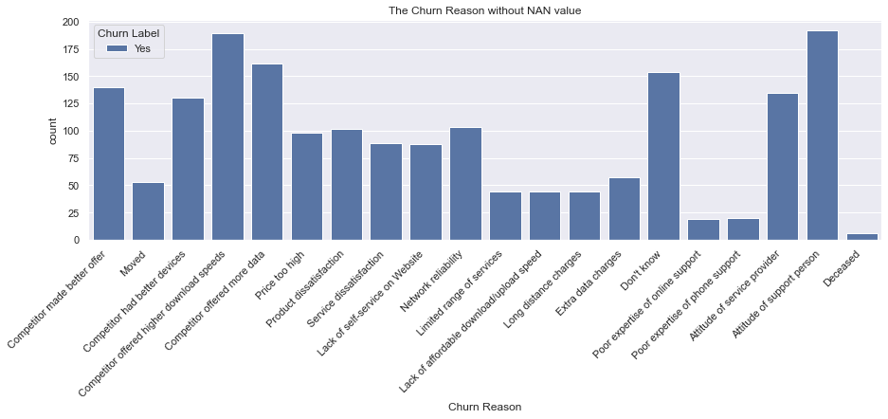
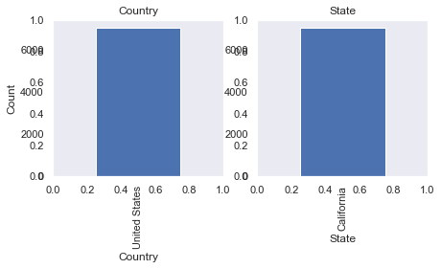
Data Preprocessing
According to previous section of data analysis and visualization we found some points,
Some features in dataset are unique (Country, State)
One feature just has information for one of label (Churn Reason)
Some features are irrelevant in our modeling (Count, Zip Code, Latitude, Longitude, CustomerID, City, and Lat Long)

Slide 8
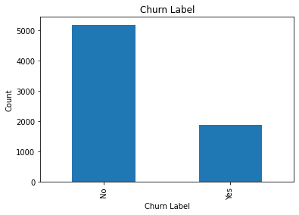
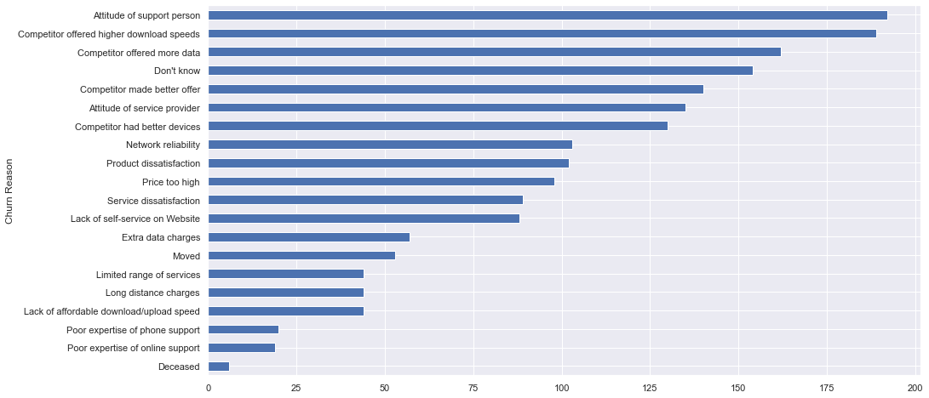
Exploratory Data Analysis
Customers who left within the last month
The result of each customer to continue contract or leave simply defined as Churn we analyze to important information about Churn
Churn Label (No: leave the company, Yes: continue contract)

Slide 9
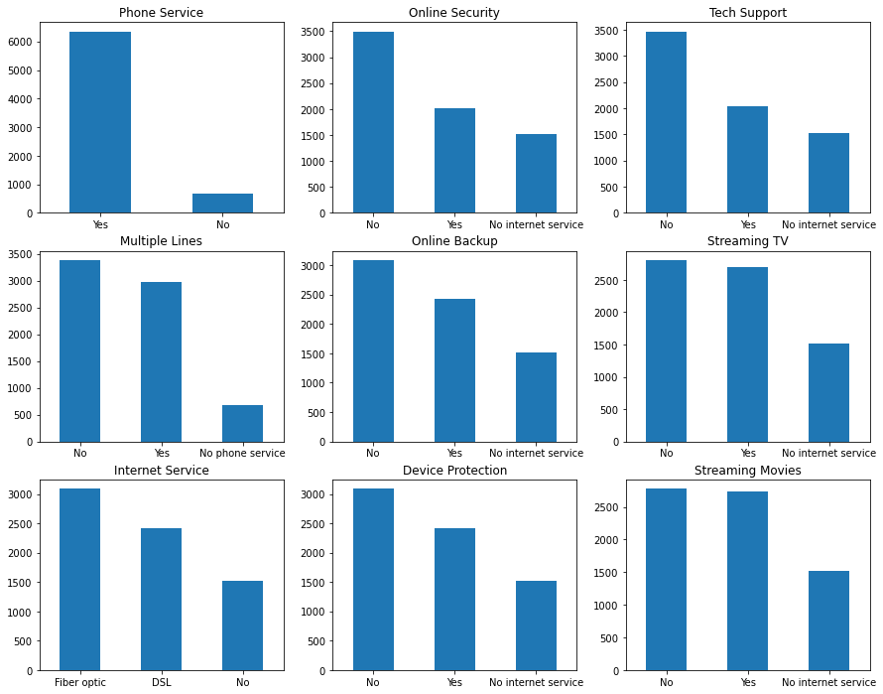
Services that each customer has signed up for
The company provide different type of services, we look statical to their information to better understanding

Slide 10
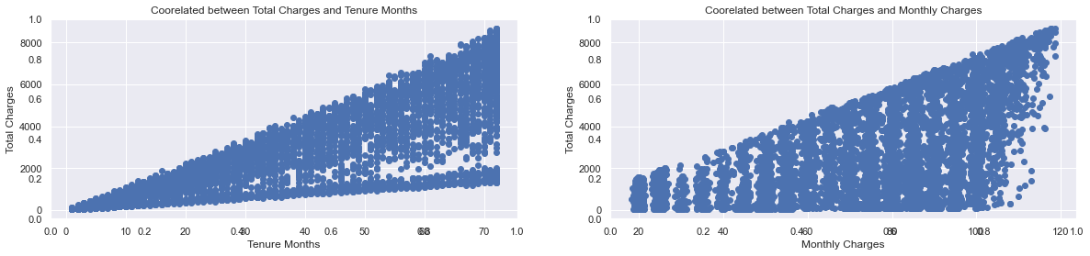
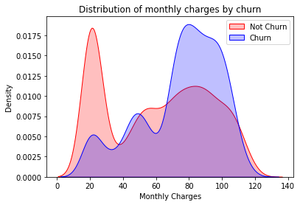
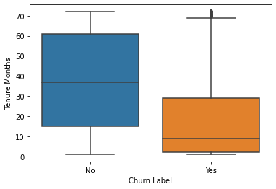
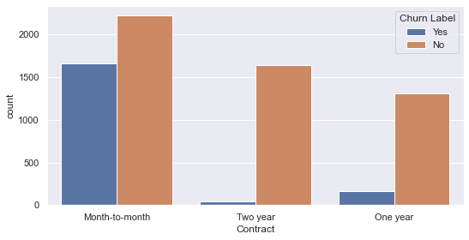
Customer account information
These providing good view of customers behavior of usage monthly

Slide 11
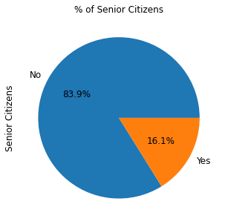
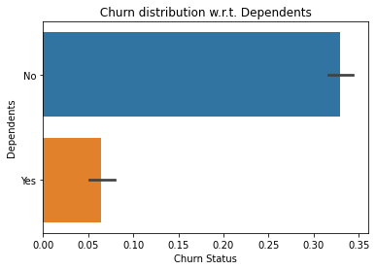
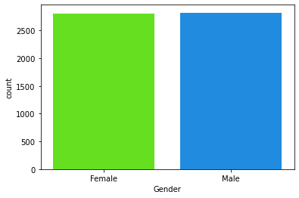
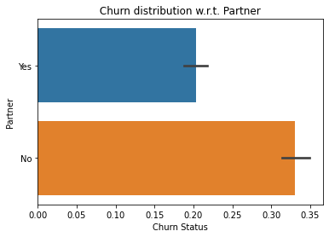
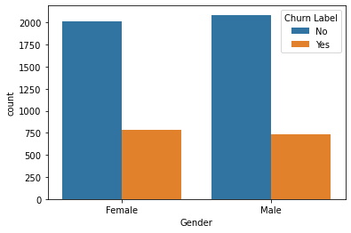
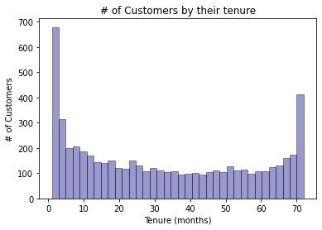
Demographic info about customers

Slide 12
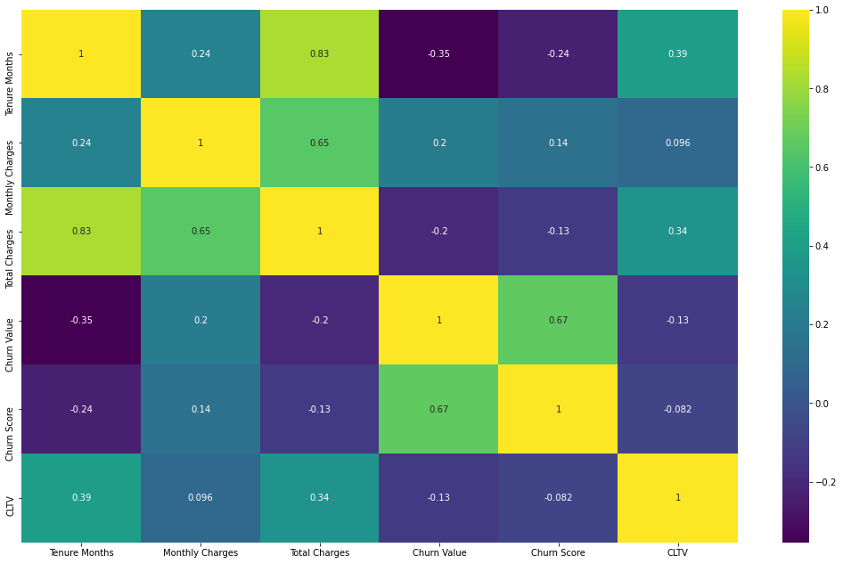
Correlation between the numerical features

Slide 13
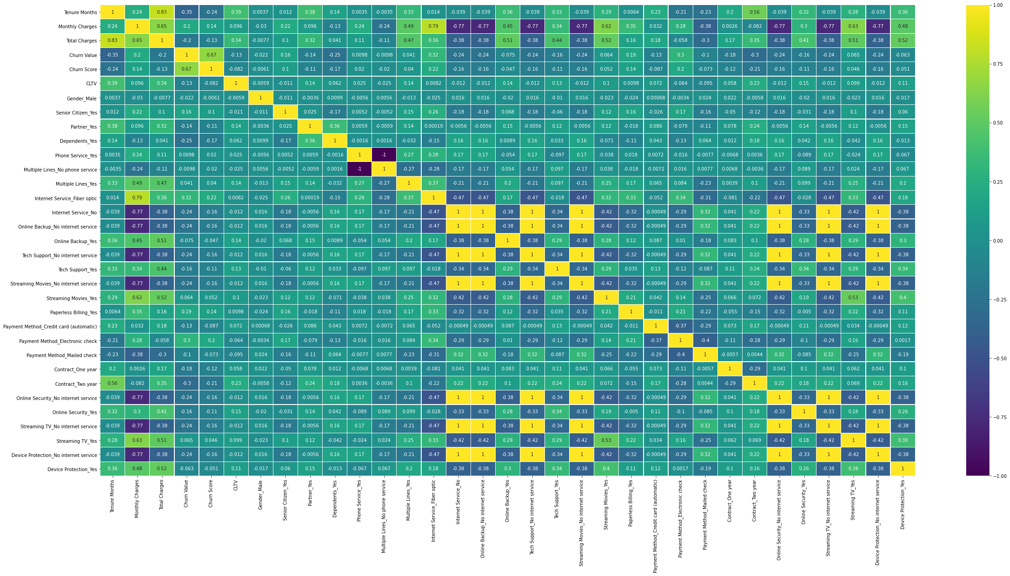
Changing features in use to Numerical for modeling Machine we use one-hot feature for this project, our reason is, the string value that exist on features don’t have related to each others.
Correlation between the features after Data Preprocessing

Slide 14
Build and evaluate the models
We will use “Supervised Classification Models” because, - Prediction of customers in danger of churn from company, and - Label of situation each customer is existing
We use different models to make comparison between them and find the best one for our job, - LOGISTIC REGRESSION MODEL - DECISION TREE MODEL - KNN MODEL - RANDOM FOREST MODEL
Machinal Learning Model | Accuracy
LOGISTIC REGRESSION MODEL | 0.9406
DECISION TREE MODEL | 0.9154
KNN MODEL | 0.8892
RANDOM FOREST MODEL | 0.9480
Based on the result table, the random forest model give the best result of accuracy, now we can to work with hyper parameters of this model to increase the accuracy

Slide 15
Conclusion
Based on Analyze - Improving the Customer Service of company with deeply looking to first layer of service - Improving the service and take the price in reasonable - Persuade and encourage customer to make long term contract - Add more advantages to using some specific services to manage the cost of growing service quality - Calculating current finance benefit of “Phone Service” and make hard decision to save the service or not
Based on Prediction Model - Most of customer that churn are similar together (learning fast and without much sample with acceptable accuracy) - Selected good features to train our Machine

